Slide 1
TURKISH CYPRIOT ASSOCIATION OF UNIVERSITY WOMEN
ACTIVITY REPORT
September 2024 – September 2025

Slide 2
Renovation of Building
This term has been quite a busy one for TCAUW board members. The building we shared with another women association, KAYAD, in which our office room is located had been under renovation for a while. Though this has caused some difficulties for us we had the chance to donate some of our furniture and books to charitable organisations . We are so glad that it is finally completed.
We have just settled in and organised our office in this beautiful historical building in the Old City of Lefkoşa and looking forward to organize meetings and host our visitors there.

Slide 3
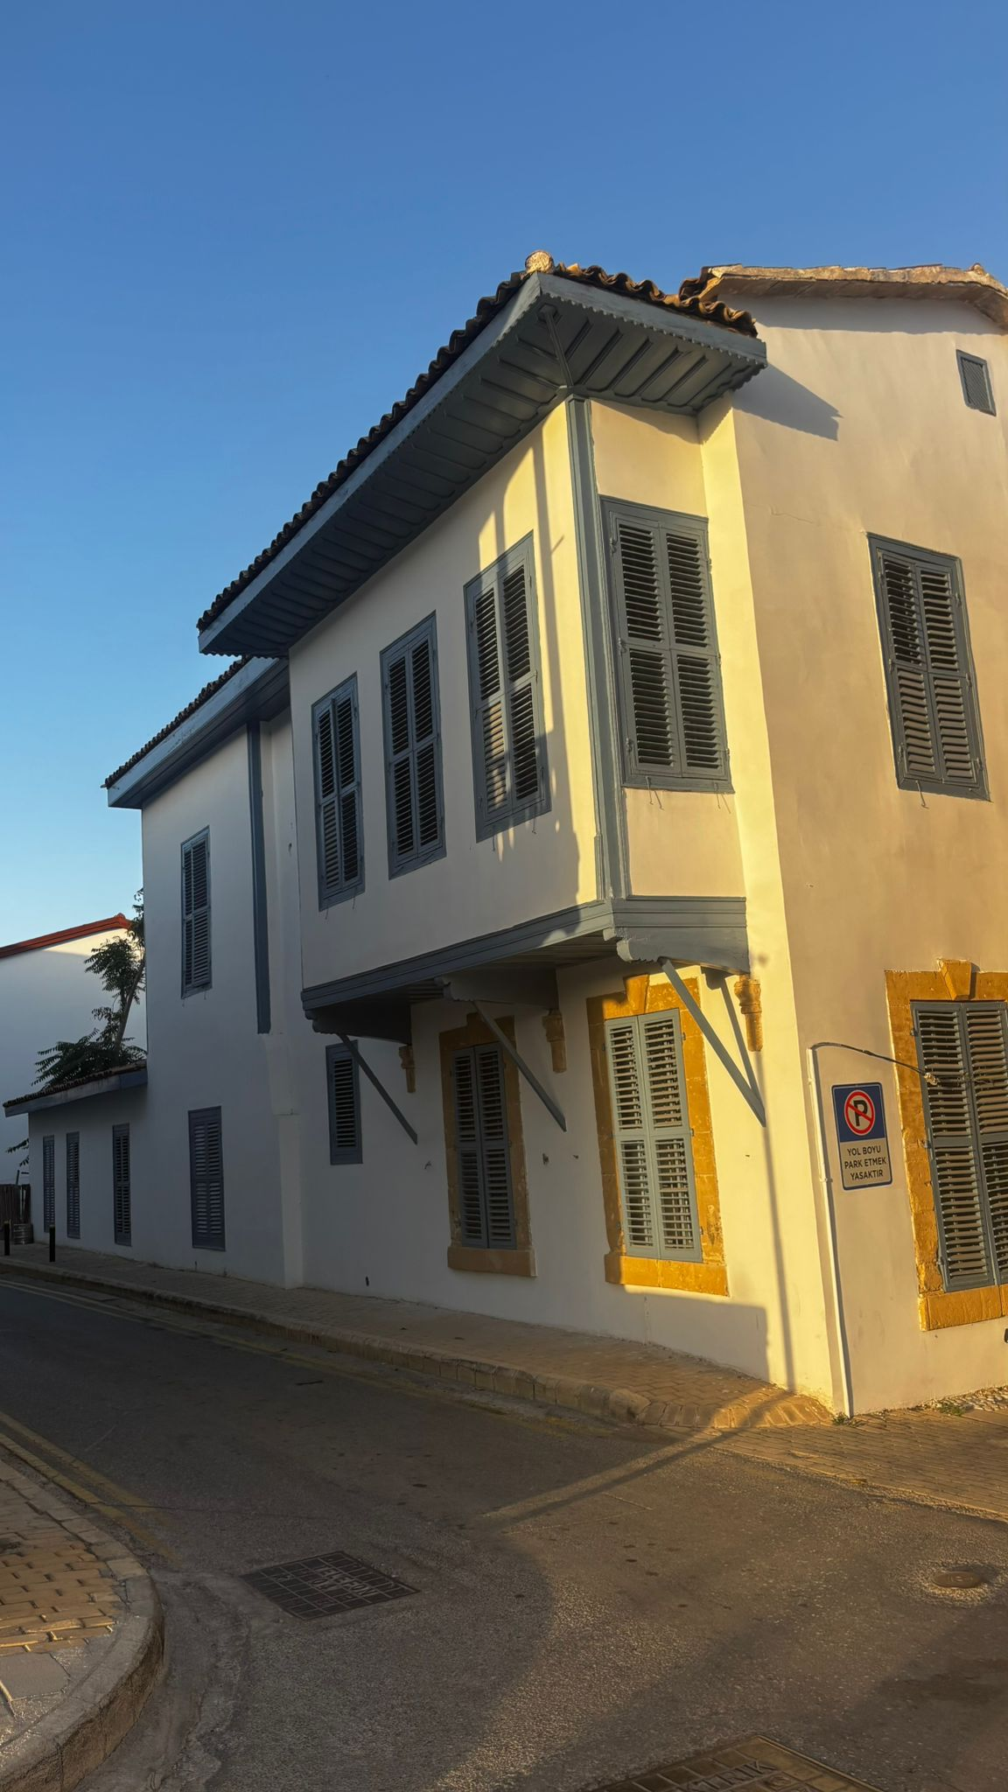
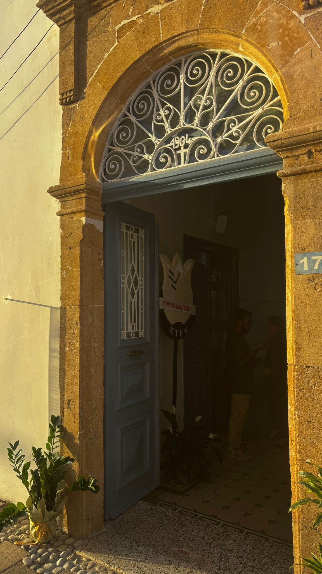

Slide 4
Parity Project
Our major project undertaken in 2023 as a three- year parity project , is expected it to be finalized in Spring 2026 .This project is financed by European Union funds and the core topic is as usual, women. With this study we are trying to define the accessibility of women to the production resources scarcely available in economics. Through the surveys on different groups of women, including refugees ,emigrants, disabled ones and LGBT+ , we have been trying to find out how extensively women can exist in labour market and be able to utilize the factors of production effectively and efficiently. The data so far gathered has been recorded and ready for the academicians to be used in their academic articles. Following the evaluation of these articles we shall finalize the project by publishing the articles in a book along with the results of the researches and surveys .This project has the significance of being the first one in conducting the time-management surveys during the process.

Slide 5
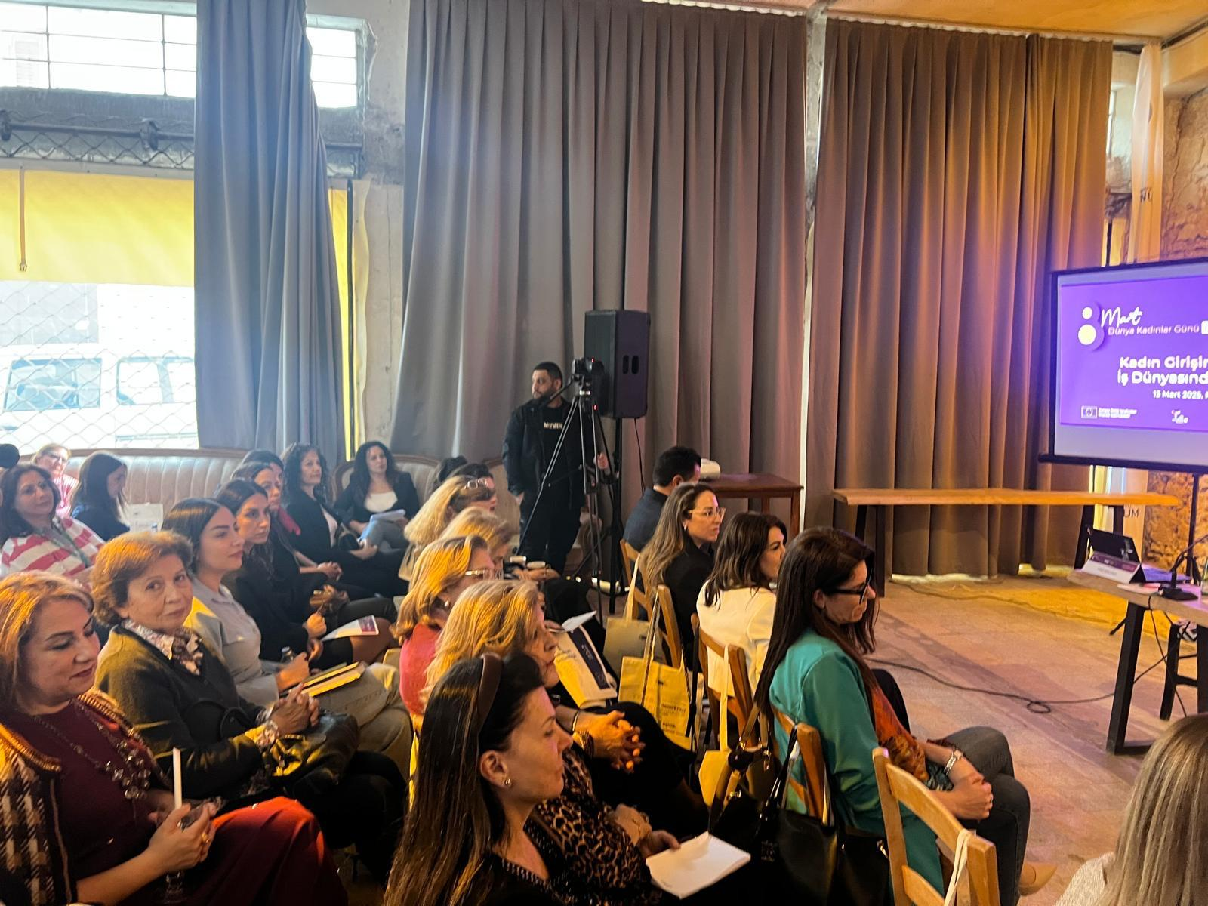
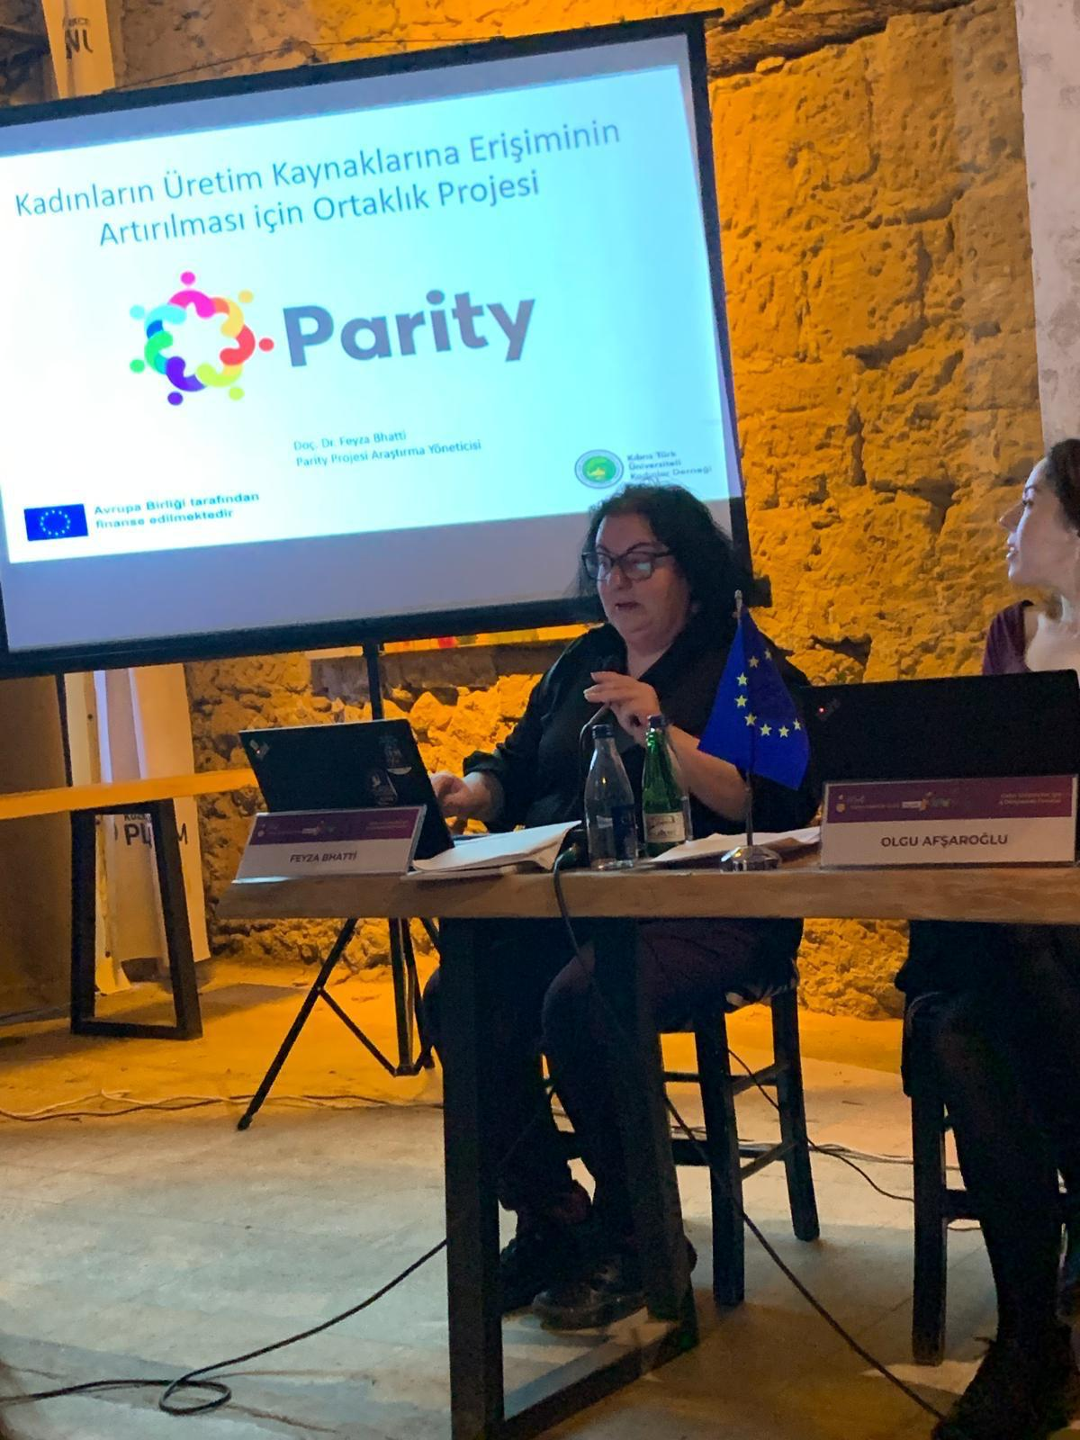
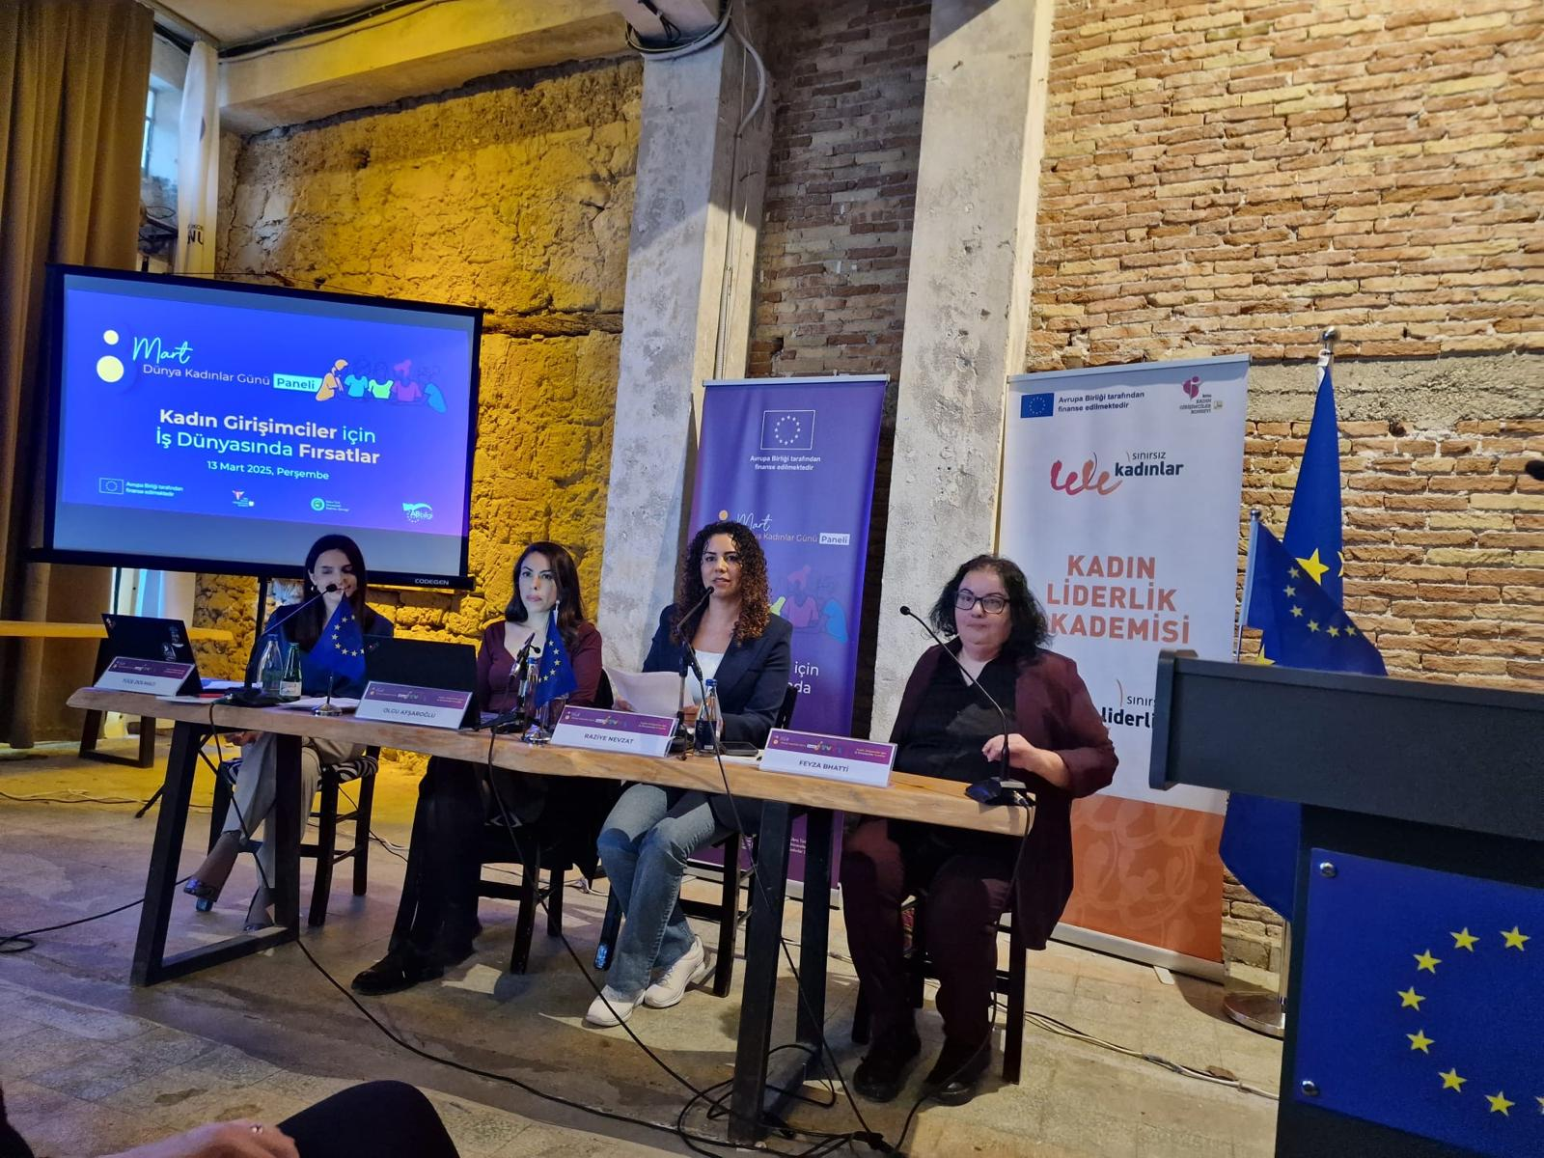

Slide 6
Engagements
Throughout the term we have been hosting some distinguished guests .The ambassador of Finland has joined us and we had a chance to discuss the issues involving education and empowerment of women.
In the last few months we had gone through an exciting time as the presidential elections in Northern Cyprus was held in October. As TCAUW is considered as influential non governmental organization on the women issues , the wives of two major candidates for the presidential office have visited the board members separately where we had been able to exchange views on various issues and problems concerning women and the community as a whole.
We were invited for a meeting with British High Commissioner, Mr Tatham ,at his office where some members of the association have also joined us and issues of politics , education ,by communal topics were discussed extensively.
In the following month we are expecting to host the French ambassador in our new office.

Slide 7
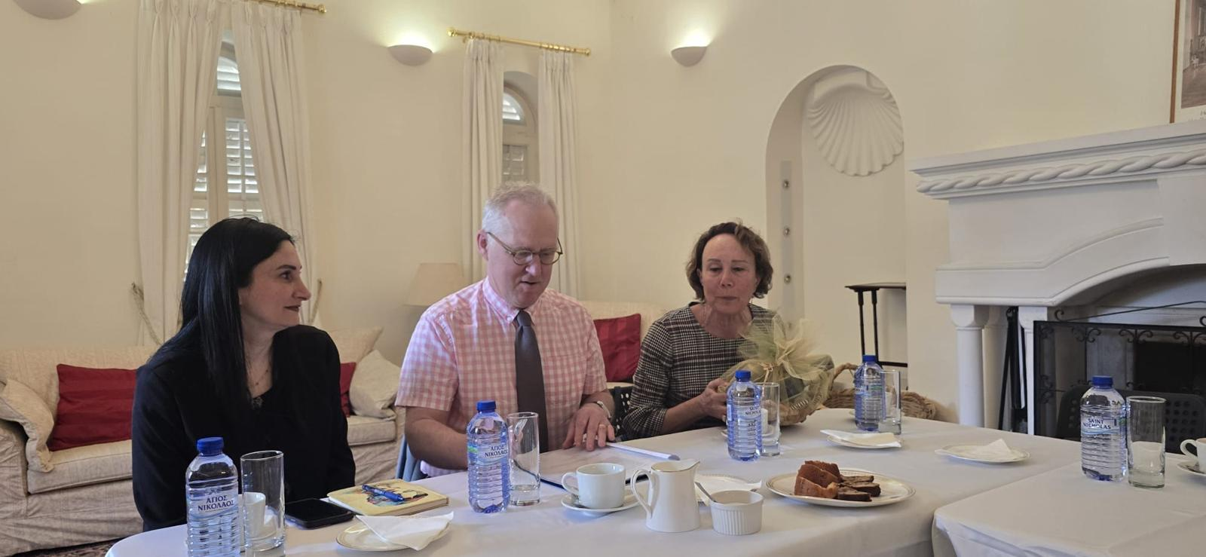
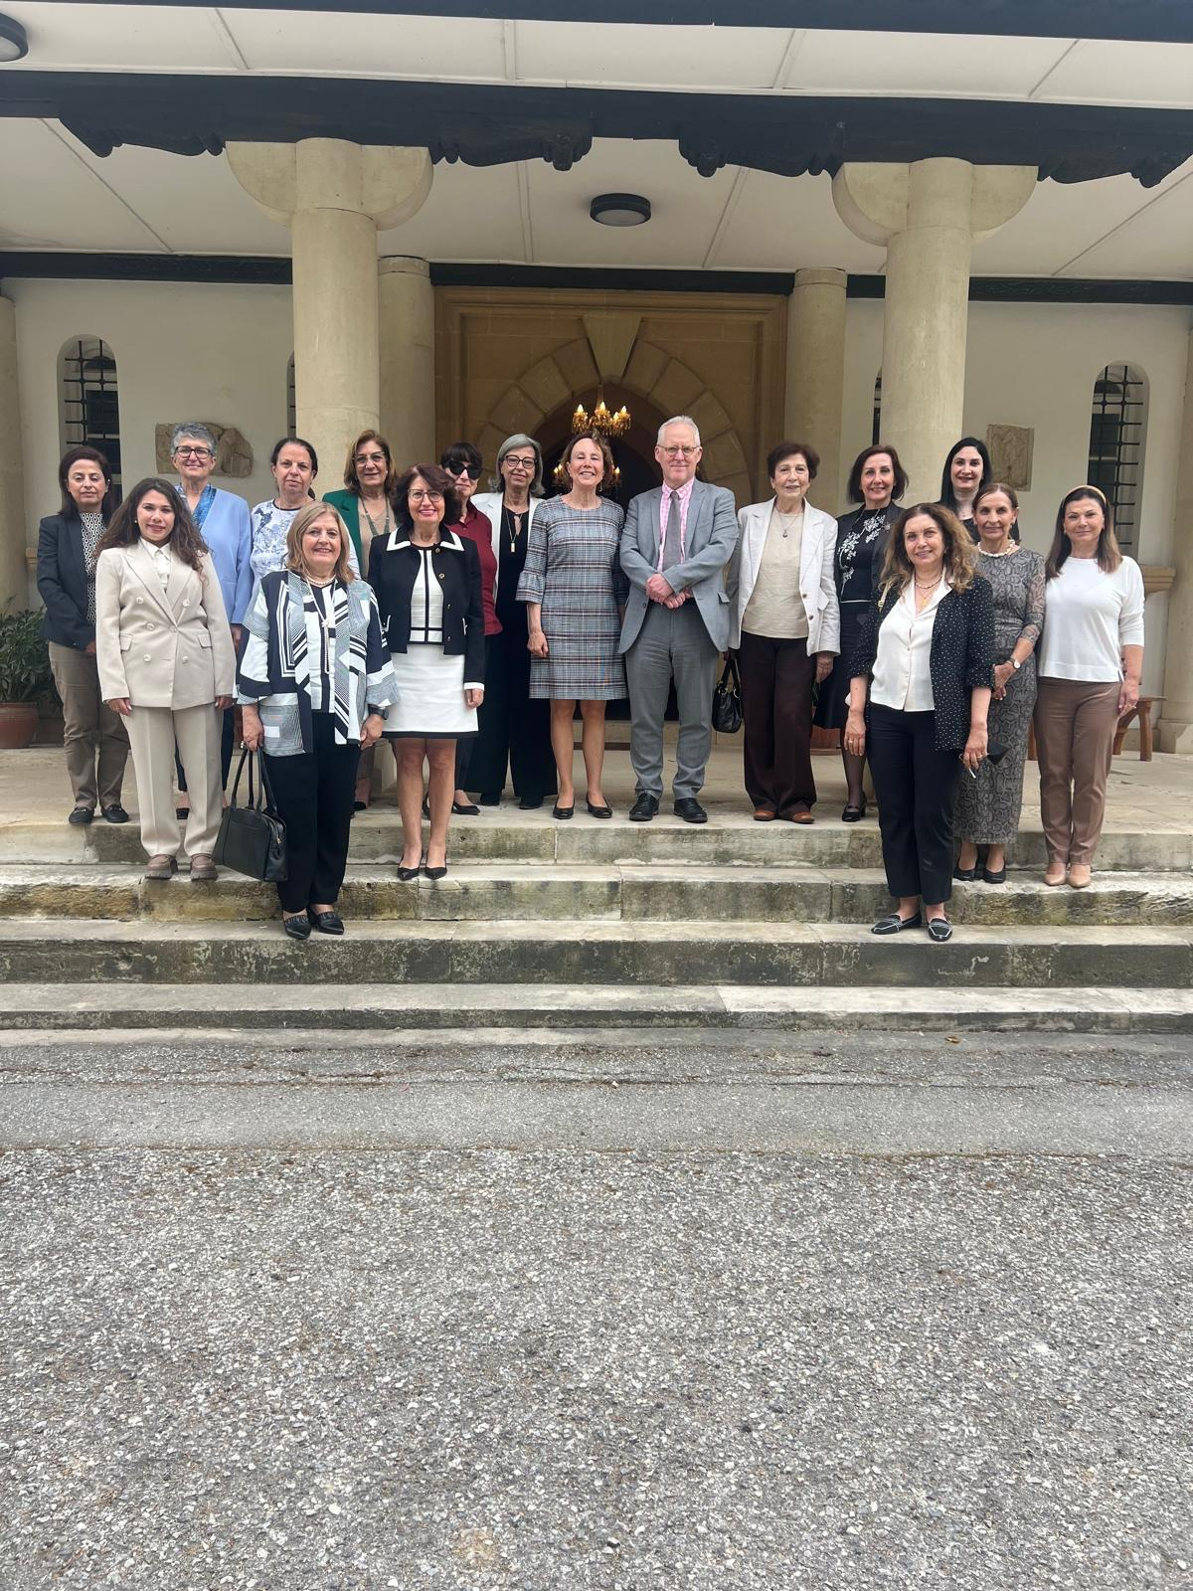
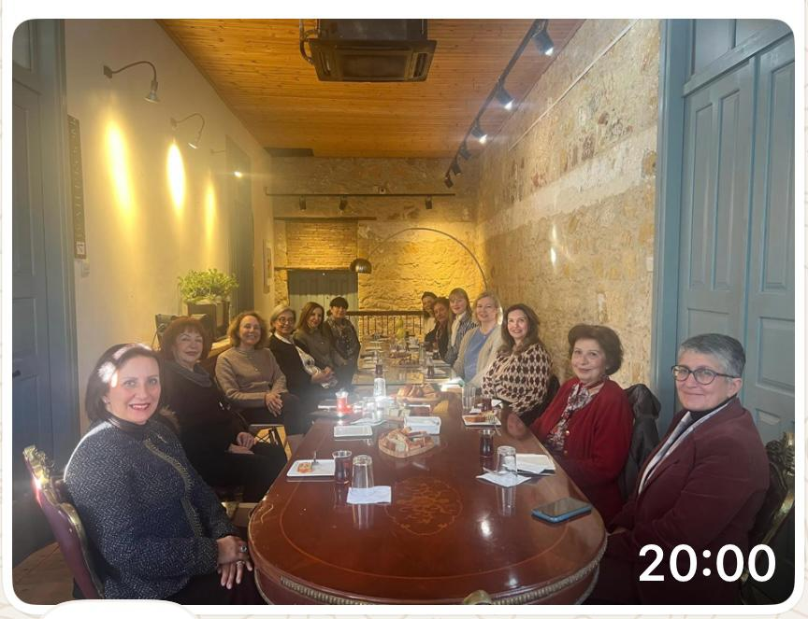

Slide 8
Cultural Activities
TCAUW has organized various cultural visits on the island .Among these visits, Troodos mountains in the southern part of the island was very educational and enjoyable.
In coordination with the bi-communal group, ‘Women in Walk and Talk ‘ sponsored by UNDP , two cultural visits were organized to Famagusta and Larnaca. In one of these organizations the guest speaker was Mrs Savina Floridon who gave very interesting information about the stones in Mediterranean Culture since ancient times. Her conference has also enlightened us about her studies of gathering words that are commonly used by both communities on the island.
The next destination will be Paphos area in the southern part of Cyprus.

Slide 9
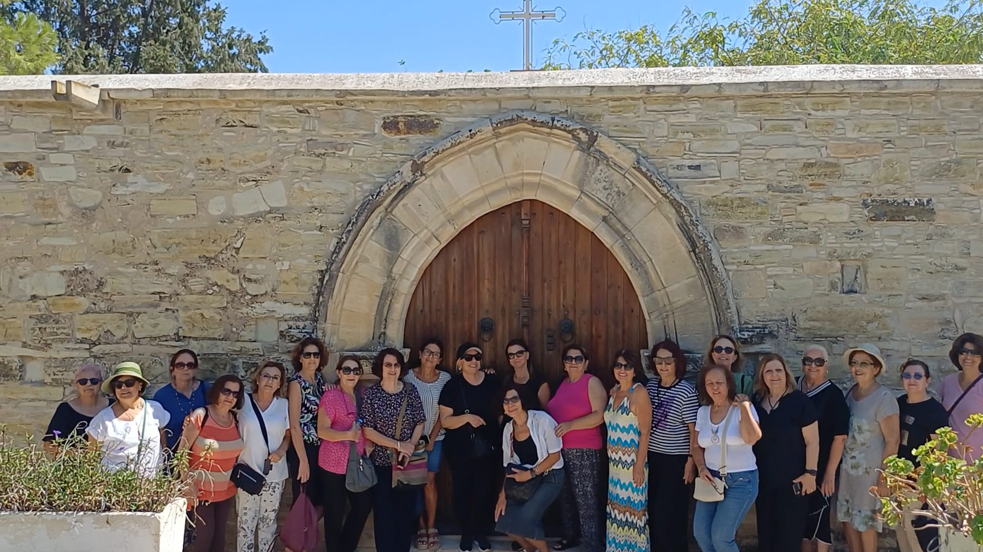
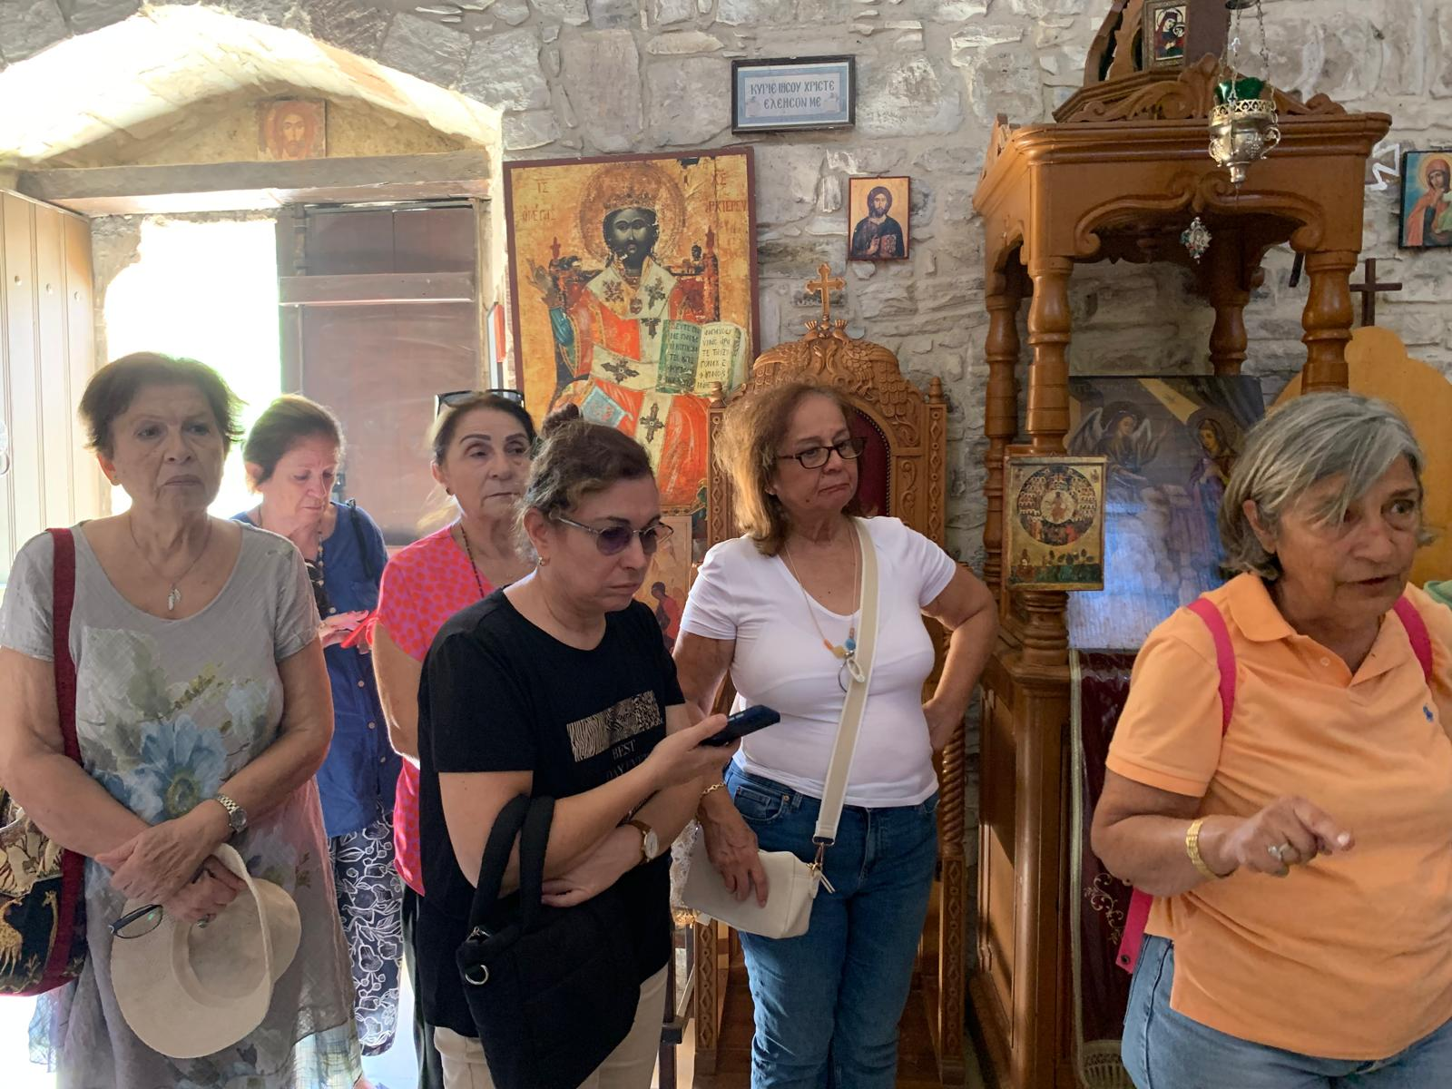
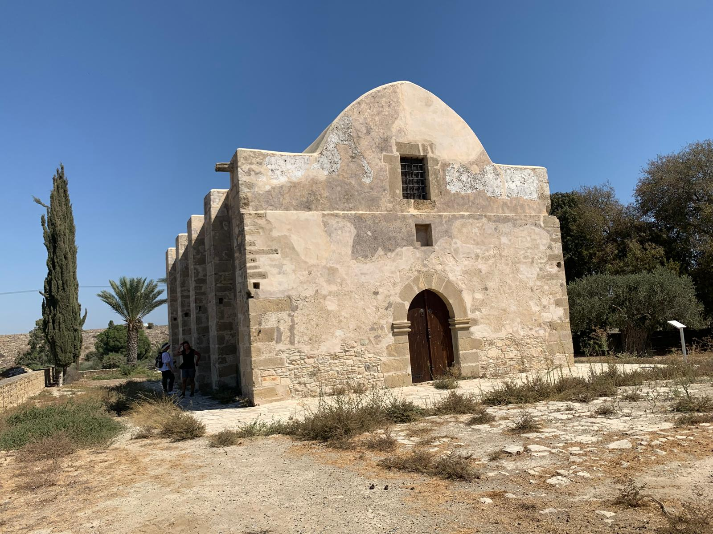
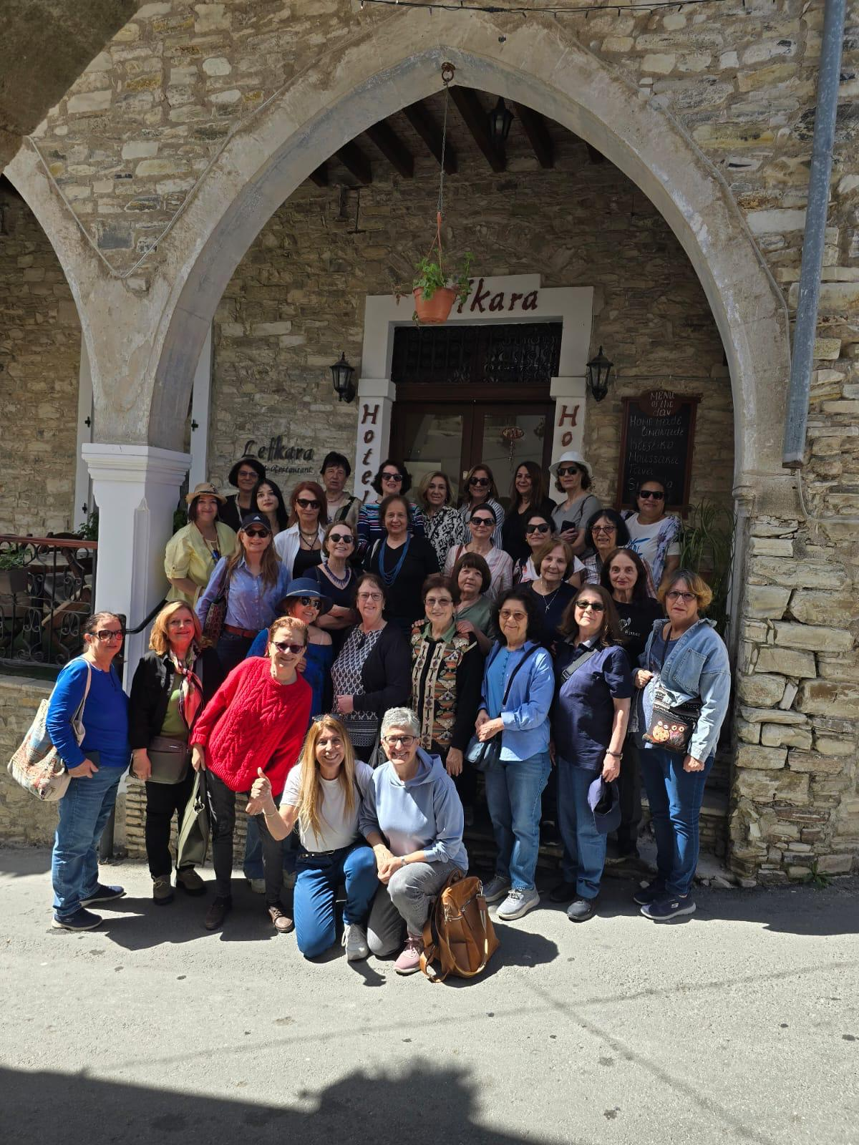
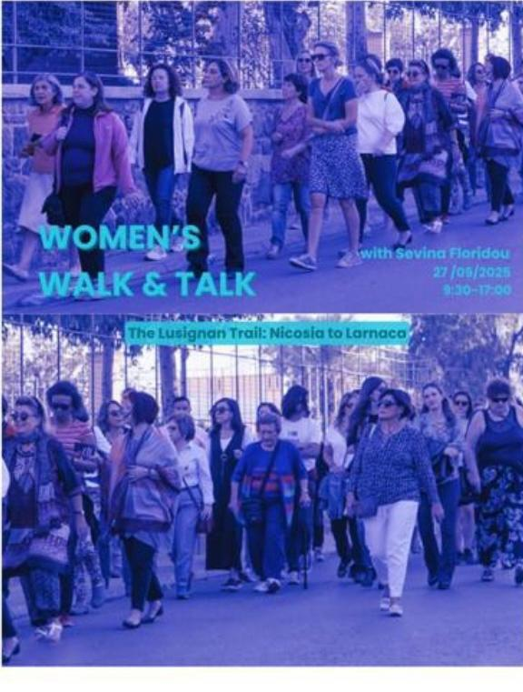

Slide 10
International Year of Cooperatives
In June 2024 ,UN General Assembly declared year 2025 as the International Year of Cooperatives, under the theme of “Cooperatives Build a Better World”. In line with this theme TCAUW together with the “Women Walk and Talk” group has organized a gathering at the Building of a Cooperation set up by four women, called 4K. These women are the producers of fresh vegetables and fruit from different regions and they transport these products to Cooperation Building for sale. As a support for this cooperation , foreign ambassadors and UN special envoy Mr Steward Collins joined the meeting as well, where everyone enjoyed the Turkish Cypriot traditional dishes prepared by these ladies. The speaker on this occasion was the former president of the Supreme Court , Mrs Narin Şefik with the topic of property issues in Cyprus.

Slide 11
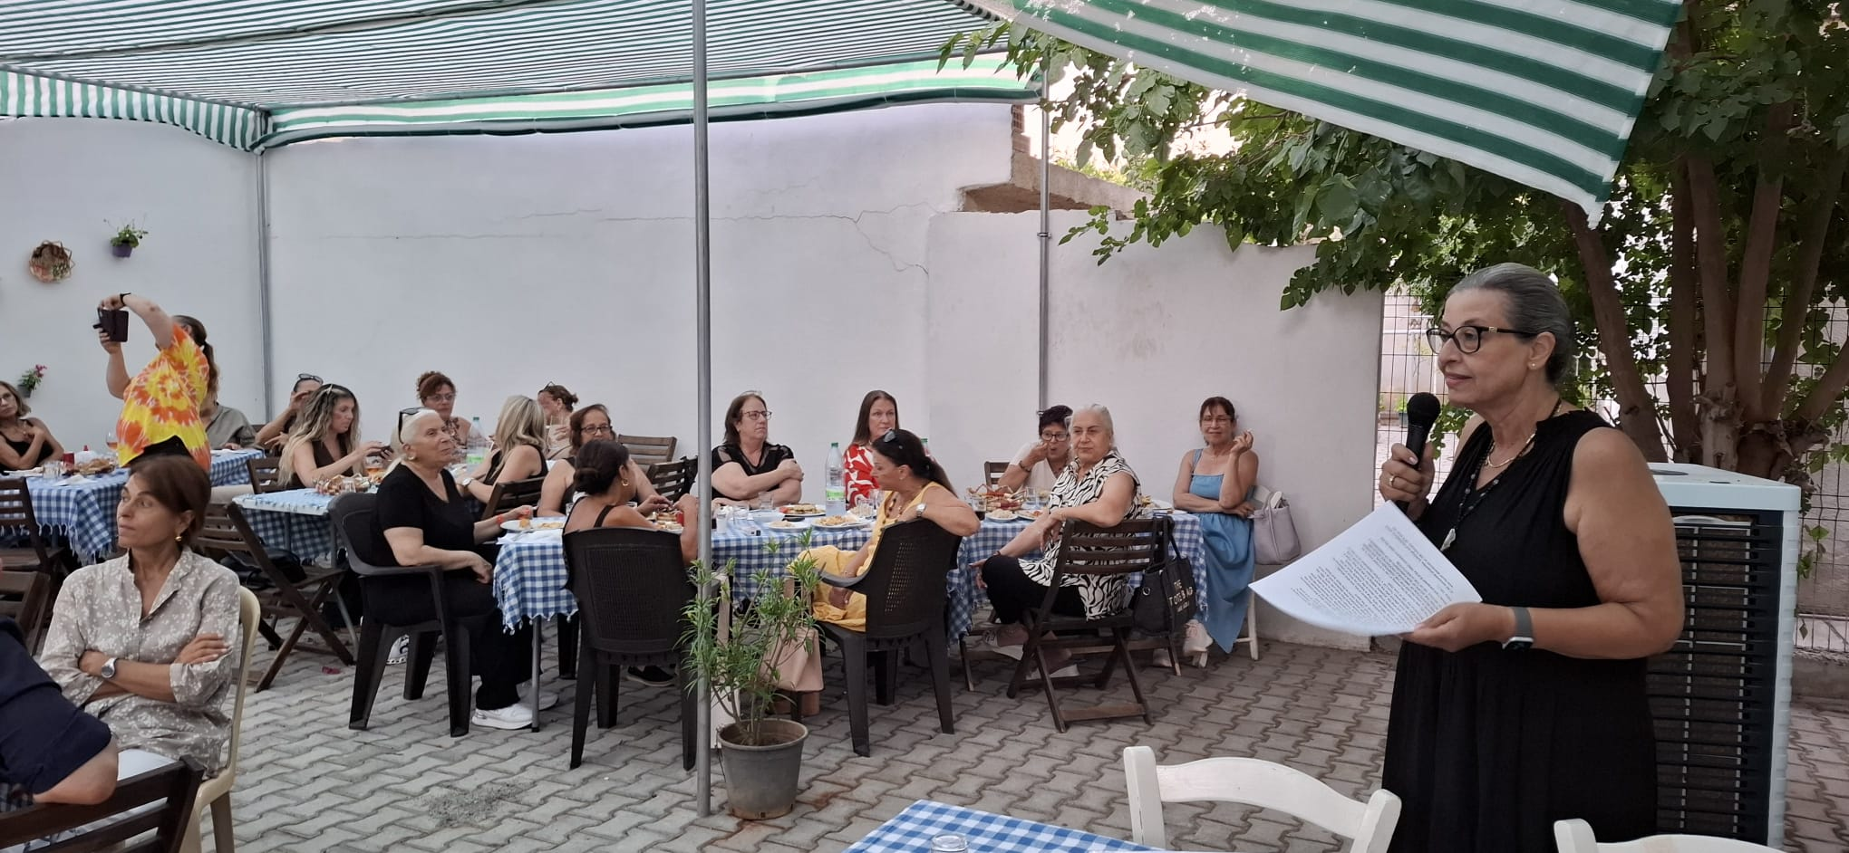
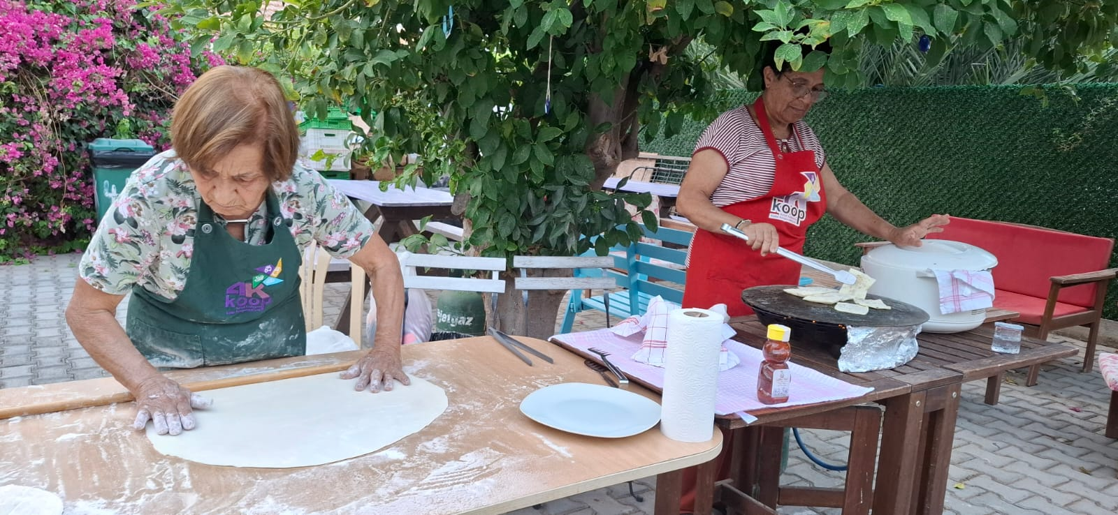

Slide 12
Workshop and Partnership
Two members of the TCAUW have joined the workshops conducted by Civil Space on the Social Indicators Identification Study with the aim of enhancing the capacity of civil society for rights-based monitoring and advocacy.
Last year we have signed a partnership with the Women Entrepreneurs’ Council ,under the umbrella of Cyprus Turkish Chamber of Commerce. We regularly participate their meetings and organizations.

Slide 13
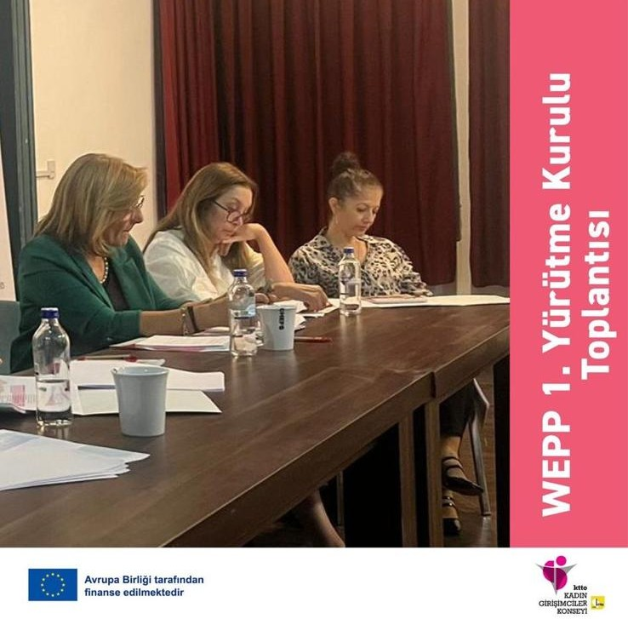

Slide 14
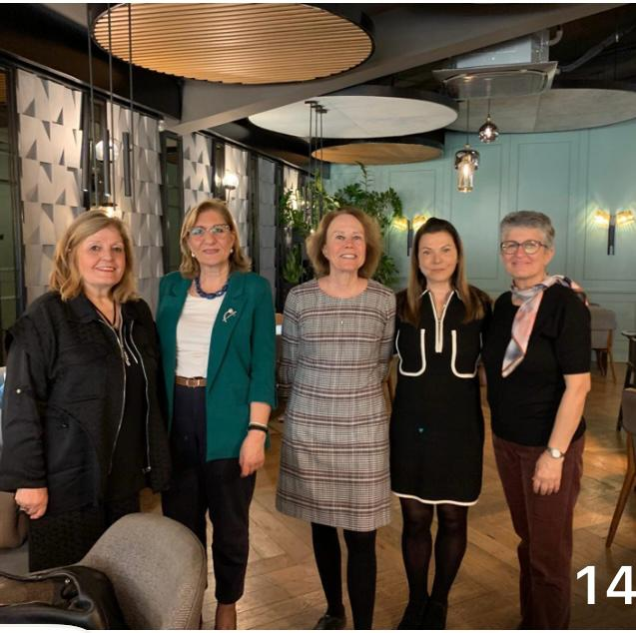
Book Club
Finally we carry on meeting with our members at our book club once a month. This year we have enjoyed reading the booker prize winners’ books. One of them was by Elenaor Catton named Luminaries, an 800 paged book, with which she won the prize as the youngest author at the age of 29. The other books we enjoyed reading and discussing this year were; “Braid” by Laetita Colombani, “Gör Beni” by Azra Cohen, “A Gentleman in Moscow” by Amor Towles, “My Brilliant Friend” by Elena Ferrante, which is one of her four book series of Neapolitan Novels and Gabriel Garcia Marquez’s “Love in The Days Of Colera”
Currently we are reading “There Are Rivers in The Sky” by the famous Turkish author Elif Shafak and we are looking forward to discussing this amazing book in the last week of November .

Slide 15
THANK YOU!

