Slide 1
Annual Report 2024–2025
from
Graduate Women International Nederland
(GWI NL)
for
UWE Conference & AGM 2025
Naples (Italy)
8th November 2025

Slide 2
GWI NL
Founded 2017
Mission: Empowering women & girls through lifelong education
Dutch GWI association
Affiliations:
  University Women of Europe (UWE)
  Dutch Women’s Council (NVR)

Slide 3
Organisation
Stable membership of approximately 40
Exploration of collaboration with VVAO whilst maintaining autonomy
Continued action for women’s rights

Slide 4
Board 2024–2025
President: Edith Lommerse
Secretary: Maryline Lamp
Treasurer: Annelies Pierrot
CER/CIR: Leonie van den Tol

Slide 5
International participation
At triennial GWI General Assembly (GA)
Saskia Voortman elected as Treasurer at GWI GA in Lusaka (Zambia) 2025
At GWI delegation to UN Commission on the Status of Women (CSW) New York (USA) 2025

Slide 6
European participation
At UWE Meet and Greets in Marbella (Spain) 2024, Durrës & Tirana (Albania) 2024 and Belfast (UK) 2025
Leonie van den Tol nominated as UWE Secretary-General
Marion Minis representative on Board of European Women's Lobby via NVR
DACH-NL Friendship Meeting in The Hague (The Netherlands) symposium 'Friendship'

Slide 7
National participation
Contribution to NVR lectures and events
Position paper submitted to political parties for parliamentary elections
Joint webinar with NVR on poverty and violence against women

Slide 8
Internal member events
Expert meeting in Hilversum: Ms Olga Rudenko, Member of Parliament Ukraine
Lectures:
  women's health: cardiology, hearing disorders
  art & history: private collections Regentenkamer Amsterdam
  museum visit Amsterdam: H’ART museum

Slide 9
Focus 2024-2025
Combating discrimination (CEDAW shadow reporting)
Economic independence and safety of women
Support for women in conflict areas
Women’s healthcare

Slide 10
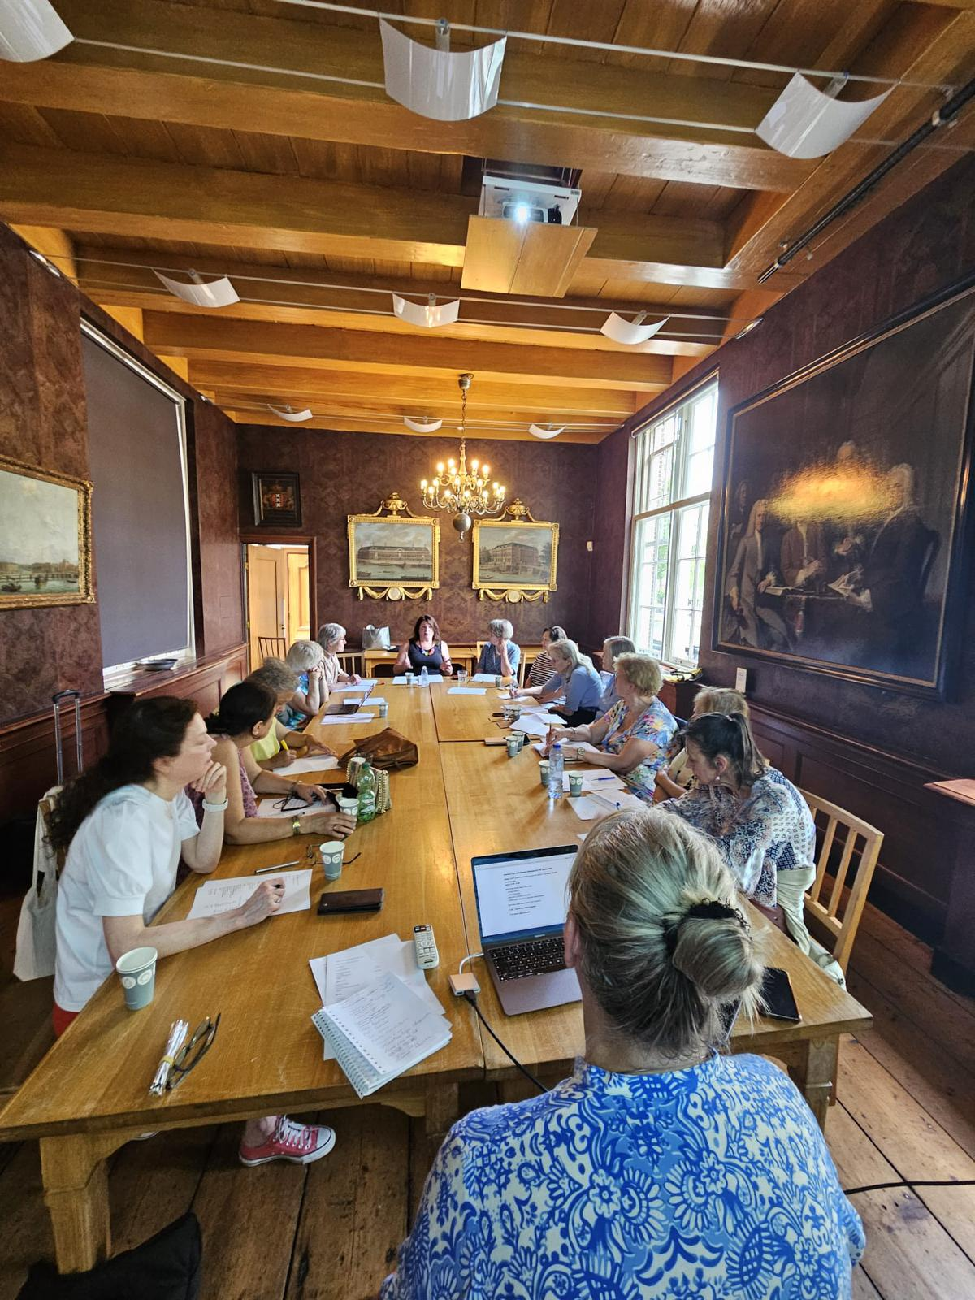
Photo
GWI NL AGM 2nd July 2025
Regentenkamer
Amsterdam
The Netherlands

